Slide 1
Intro to Agile
1

Slide 2
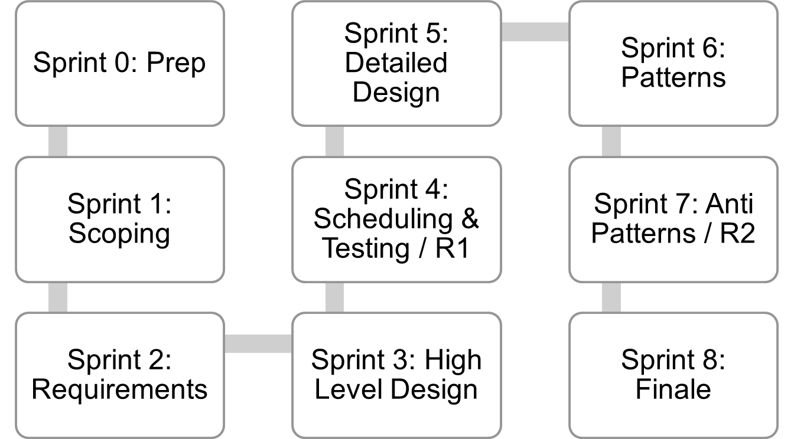
Where are we..
Jan 4
Mar 12
Mar 26
Lecture topics will follow this flow
As the projects tracks these sprints
Submissions due along the way
Guest lectures from startups and Industry leaders
EACH SPRINT IS 2 WEEKS, Friday start.
Jan 15
Feb 26
Apr 9
Jan 29
Feb 12
April 23
April 23+ EVALUATIONS

Slide 3
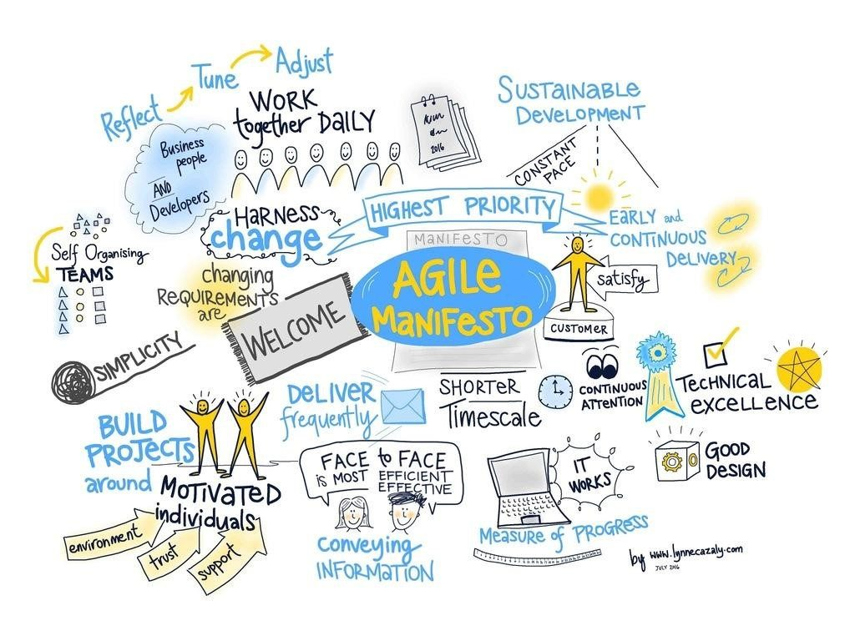
Agile methodology
is a type of project management process,
mainly used for software development,
where demands and solutions evolve
through
the collaborative effort of self-organizing and cross-functional teams and their customers

Slide 4
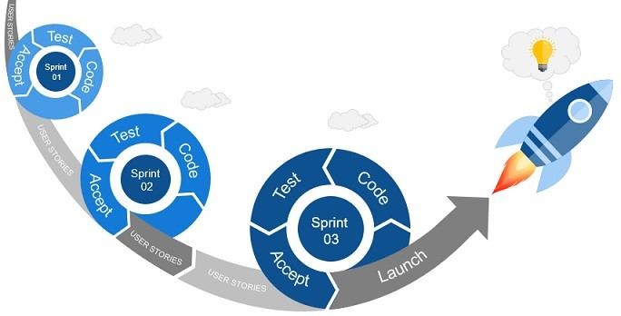
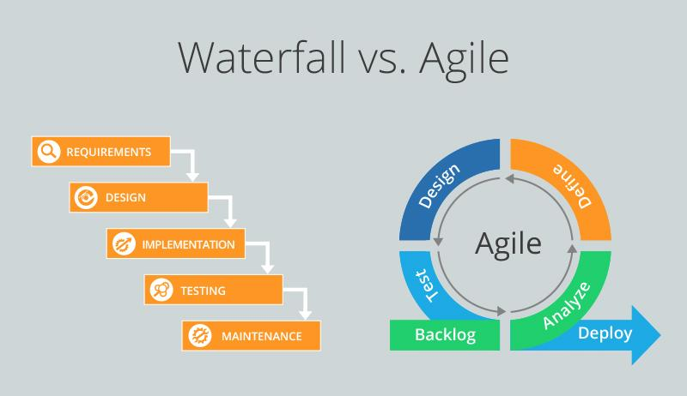

Slide 5
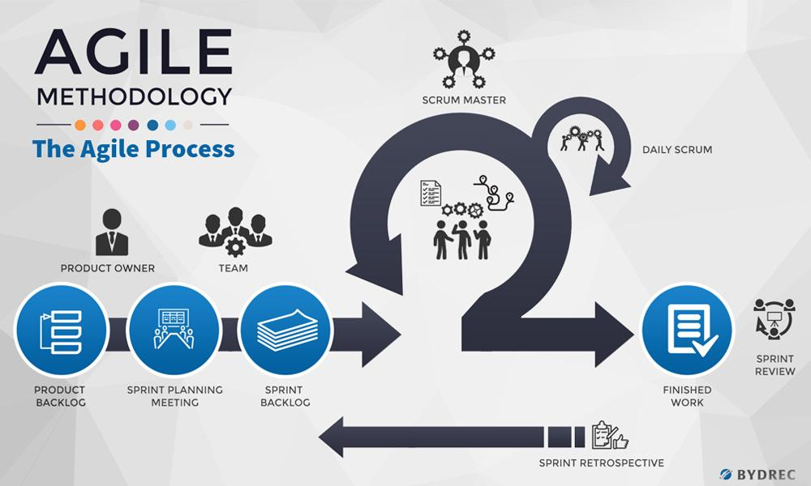

Slide 6
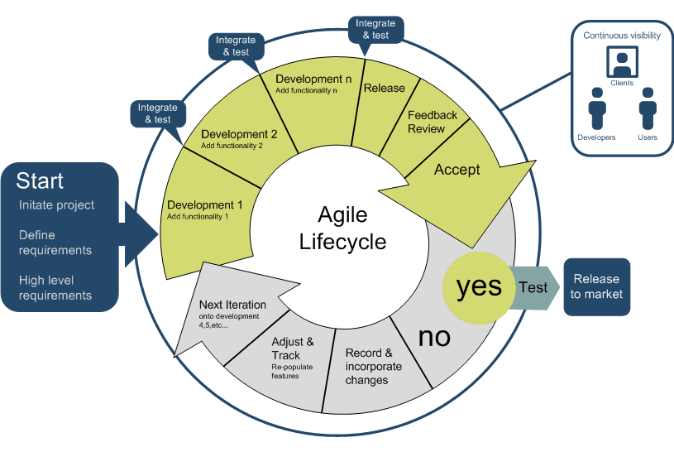

Slide 7
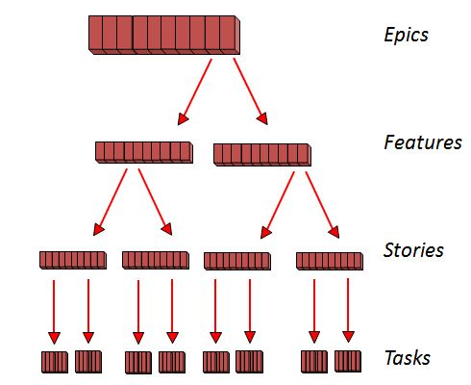
In Agile
7

Slide 8
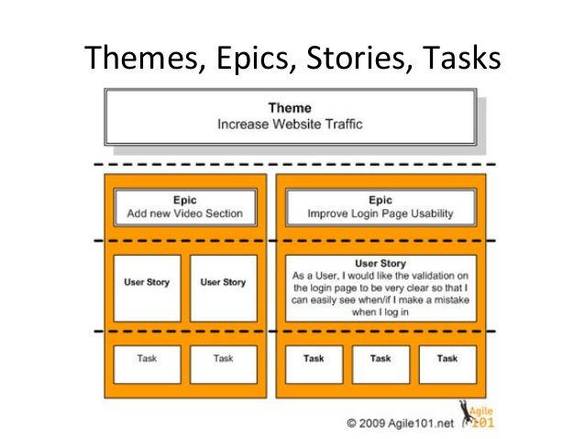
Example
8

Slide 9
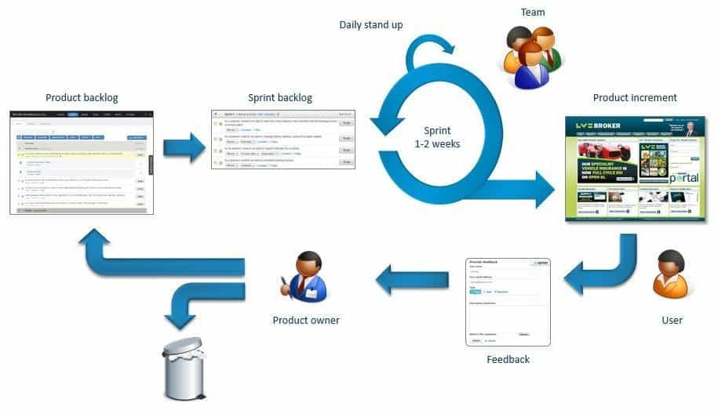
Agile.. Backlog at core

Slide 10
Thanks

